Slide 1


The Impact of
Cybersecurity on
Jamaica’s Banking System
Through Domain Abuse
Presented By:
Shanelle McPherson
Copyright © IMARC Service Pvt Ltd. All Rights Reserved

Slide 2
What is a Cyber Attack?
Unauthorized system/network access by a third party.
The person who carries out a cyber attack is termed as a hacker/attacker
Data Breaches
Financial Losses
Hampers Customer Trust
Reputational Damage

Slide 3


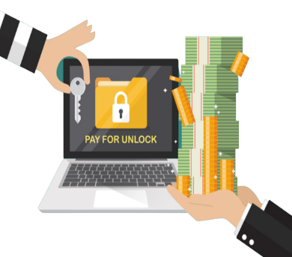
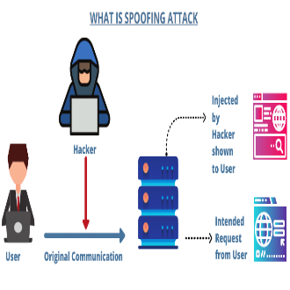
Top Cybersecurity Threats Faced by Banks
Trojan
A malicious computer application created to access private data processed or kept by online banking systems.
Phishing
A type of social engineering attack wherein an attacker impersonates to be a trusted contact and sends the victim fake mails.
Ransomware
A type of malware that prevents users from accessing their system or personal files and demands ransom payment in order to regain access.`
Spoofing
Hackers use a clone site in this type of cyberattack. By posing as a financial website

Slide 4

Cyber Attack
Impact
David Noel- President of the Jamaica Bankers Association
Jamaica Banks experience two cyberattacks per week on average.
Hacker made off with 10 million in 1 month
Average lost $4 million per month
Between January and September 2018, 62 counts of internet banking fraud.
$38.2 million losses or 4.2 million per month on average, published by the Bank of Jamaica

Slide 5
Mitigating Threat of Cyber Crimes
Establishment of a Cyber Emergency Response Team(CERT)
National Cyber Security Taskforce
Jamaica Cyber Incident Response Team(JaCIRT’S)
https://www.cirt.gov.jm/
JaCIRT’S Responsibilities
Incident management, response and continuity planning.
Forensic analysis of digital artifacts and custody of evidence.
Vulnerability assessments, penetration testing and security audits.

Slide 6
ICANN’S DNS Security Threat
Mitigation Program
ICANN Domain Name System (DNS) Security Threat Mitigation Program strives to make the internet a safer place for end users by reducing the prevalence of DNS security threats across the internet.
Harmful DNS Abuse:
Botnets
Malware
Pharming
Phishing
Spam

Slide 7
ICANN’S DNS Security Threat
Mitigation Program
ICANN’S Domain Abuse Activity Reporting (DAAR) system
Monitors domain abuse registration activity across top-level domains(TLDs)
Continuously collects registration and security threat data from numerous reputation data feeds.
Reputation Block List(RBL) security threat data feed.
Compiled using different methodologies such as crowd sourcing, spam filters, and honeypots, among others.
DAAR system can serve as a platform for studying, reporting daily, or historically the registration data, or the abuse activities.

Slide 8
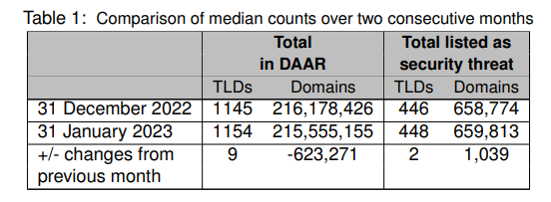
ICANN’S DAAR REPORT
Data collected is used to generate monthly report of all TLDs for which data available
Provide stats and time series analyses about security threats

Slide 9
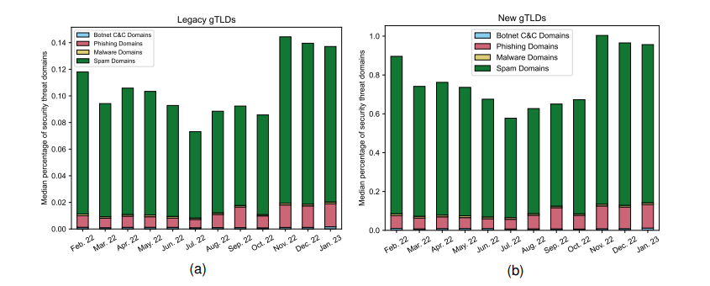
ICANN’S DAAR REPORT
The overarching purpose of DAAR is to develop a robust reliable, and reproducible methodology for analyzing security threat activity , which the ICANN community may use to make informed policy decision.

Slide 10
ICANN’S DNSSEC- Domain Name System Security Extensions
ICANN Domain Name System Security Extension (DNSSEC) strengthens authentication in DNS using digital signatures based on public key cryptography. With DNSSEC, it's not DNS queries and responses themselves that are cryptographically signed, but rather DNS data itself is signed by the owner of the data.
DNSSEC adds two important features to the DNS protocol:
Data origin authentication allows a resolver to cryptographically verify that the data it received actually came from the zone where it believes the data originated.
Data integrity protection allows the resolver to know that the data hasn't been modified in transit since it was originally signed by the zone owner with the zone's private key.

Slide 11
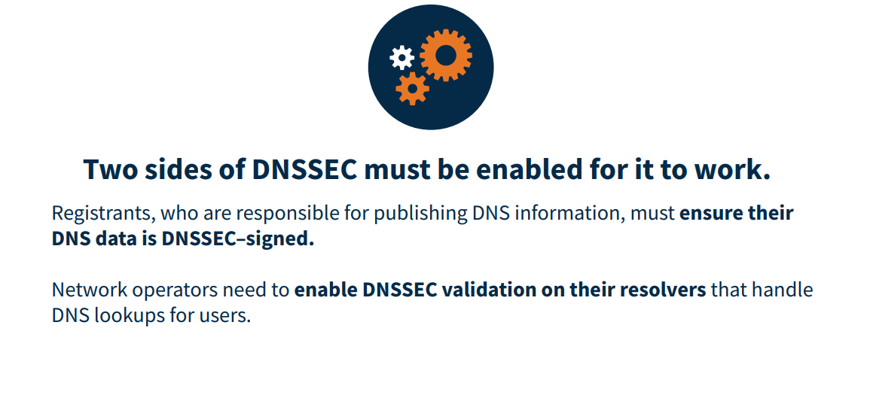
DNSSEC Operation

Slide 12
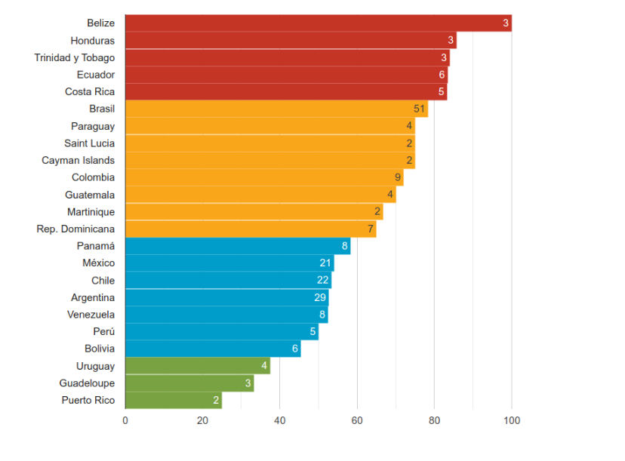
DNSSEC Deployment in the Region –
Statistics and Measurements
Ranking based on average DNSSEC validation rates from networks in the countries of Latin America and the Caribbean corresponding to May 2022.
Reference:
G. (2022, August 17). DNSSEC Deployment in the Region – Statistics and Measurements. LACNIC Newsletter. https://news.lacnic.net/en/routing/dnssec-deployment-in-the-region-statistics-and-measurements

Slide 13


Contact Information:
Address : Kingston, Jamaica
Contact : 876-333-3447
Email : mcphersonshanelle@yahoo.com
THANK YOU
LinkedIn :
Shanelle McPherson
https://www.linkedin.com/in/shanelle-mcpherson-98637b13b

